Slide 1


VASAVI COLLEGE OF ENGINEERING (AUTONOMOUS)
IBRAHIMBAGH, HYDERABAD – 500 031
ACCREDITED BY NAAC WITH 'A++' GRADE
Department of Information Technology
DEPRESSO-
MENTAL HEALTH BLOG

Slide 2
Basic Details of the Team and Problem Statement
Tech Savishkaar
Theme Name: Health Care
Problem Statement Title: Mental Health Blog

Slide 3
Idea/Approach Details
Describe your idea/Solution/Prototype here:
A Mental Health Blog web application which take’s up a questionnaire’s of based on situation situations and detecting the range of depression (low, medium, high).
Based on the level of depression they can take up the different kinds of therapy’s which are provided by our website.
If the level of the depression is high , our website will provide the feature to consult the different type’s of doctors.
Describe your Technology stack here:
Html
Css
Java script
Php
Python
Decision tree classifier (ml algorithm)
Mask R-CNN (dl algorithm)

Slide 4
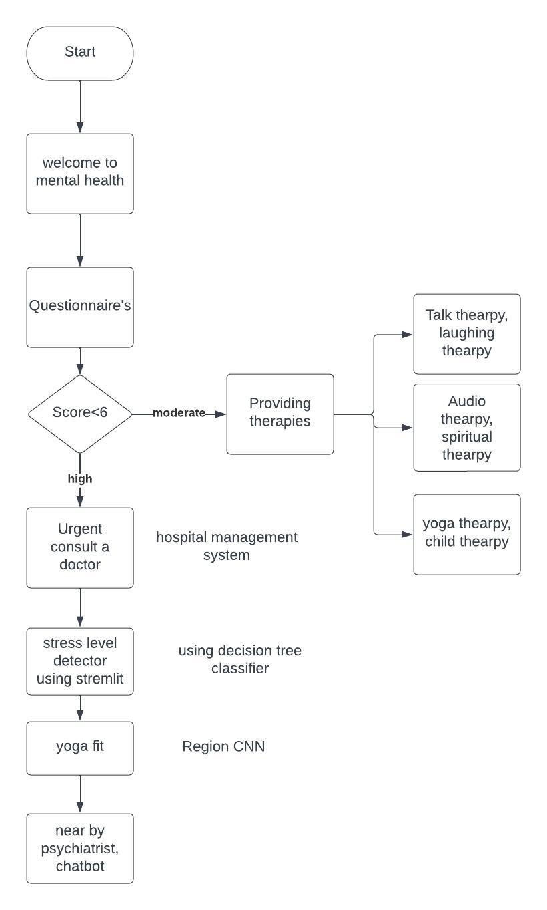
FlowChart:

Slide 5
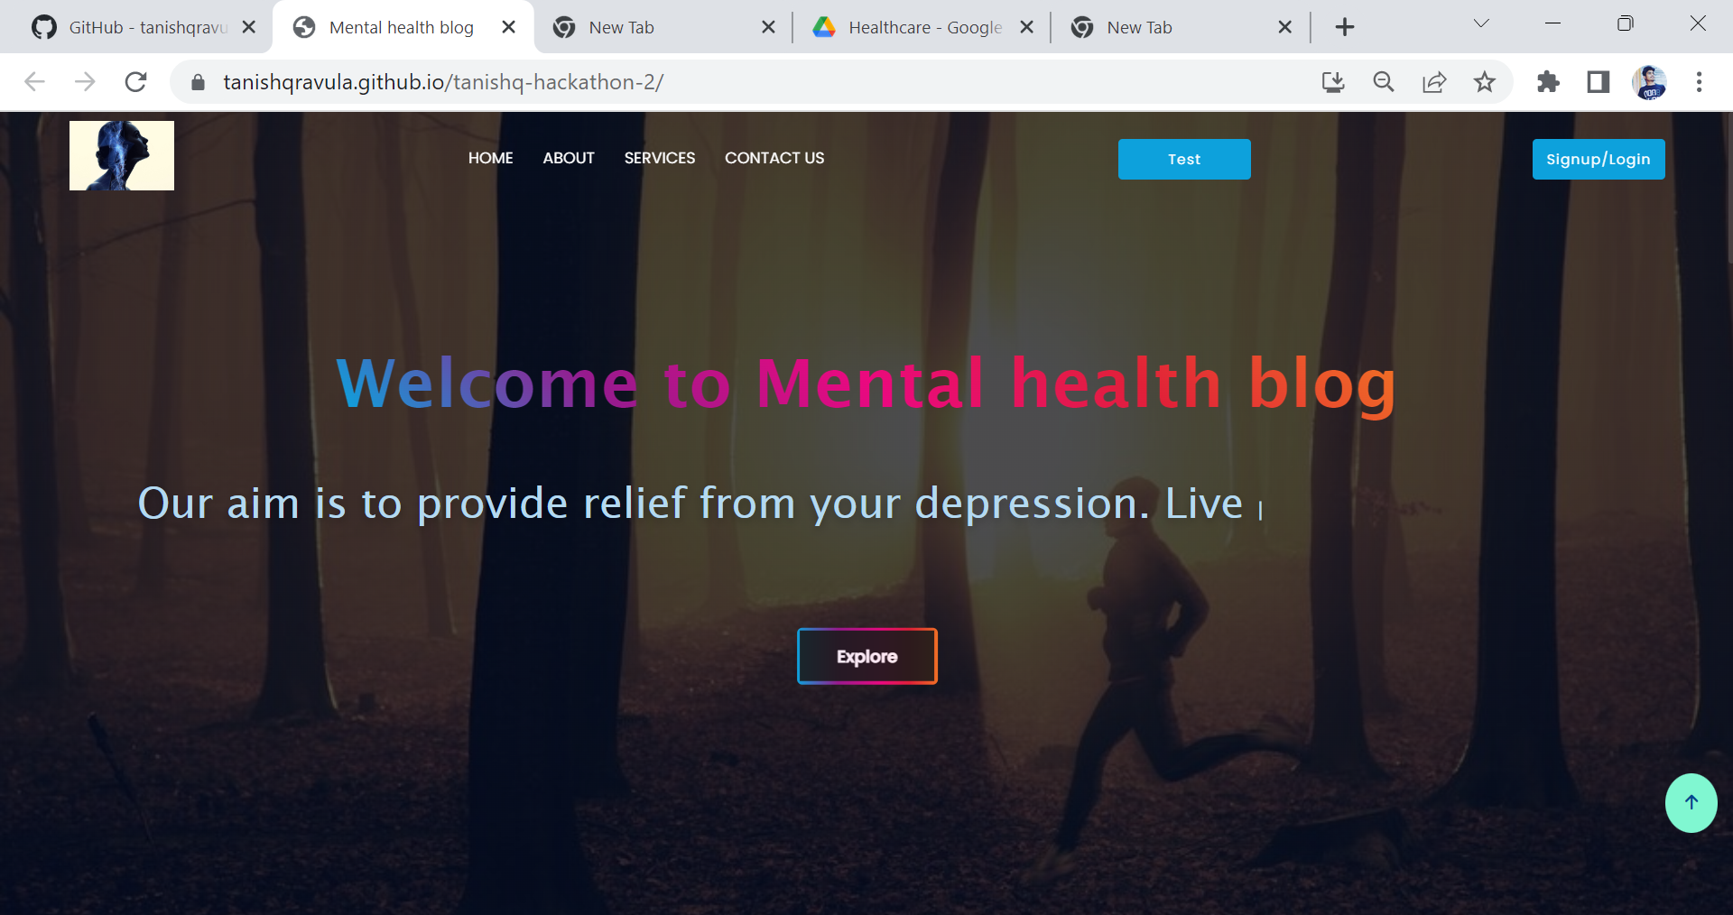
Screenshots of Project:

Slide 6
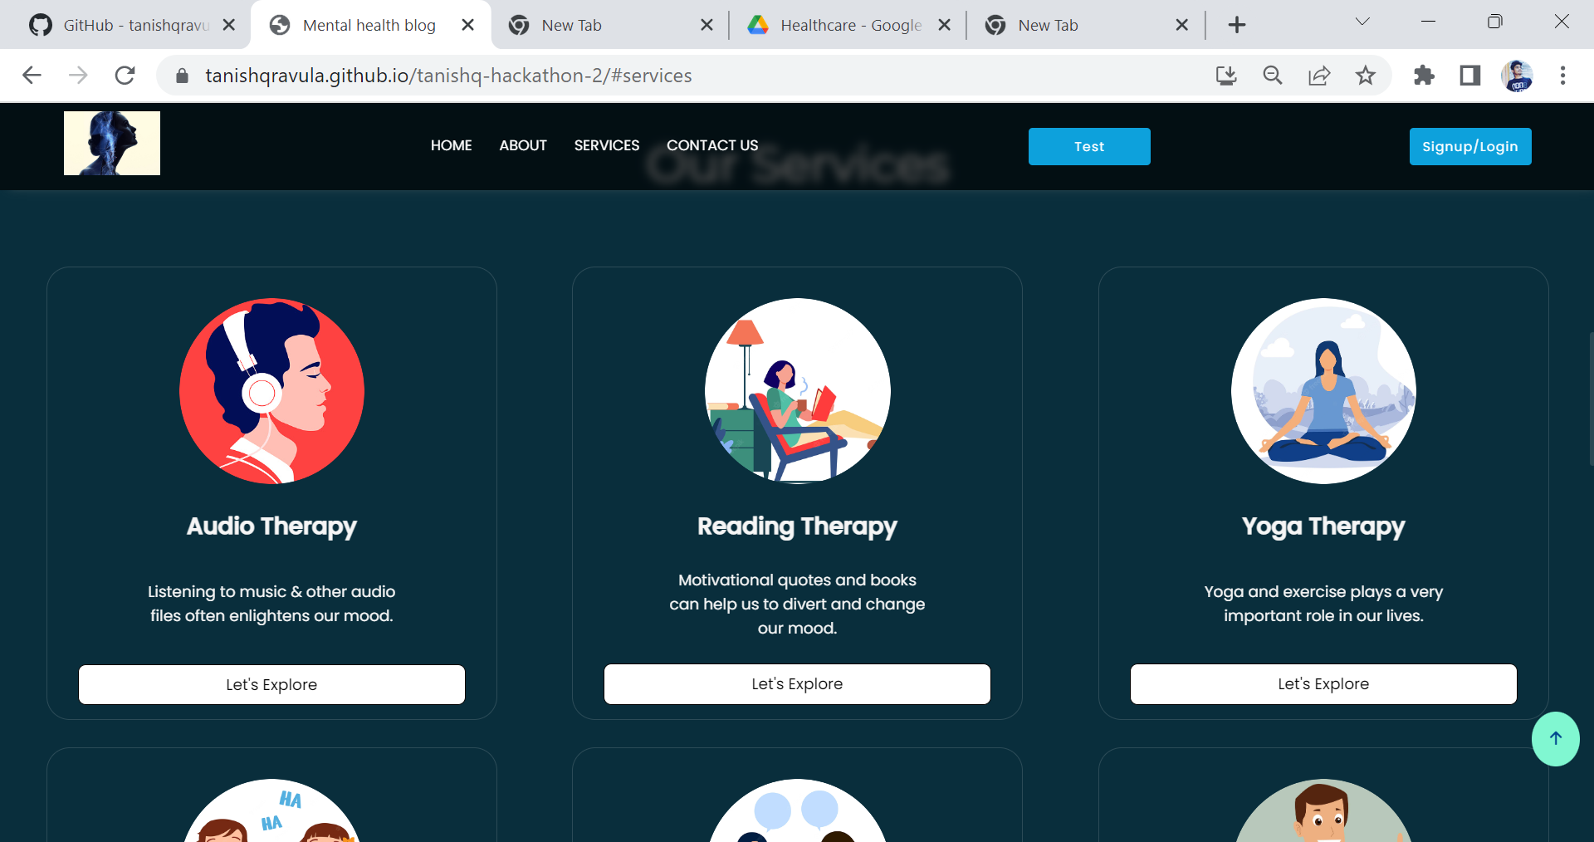
Services:

Slide 7
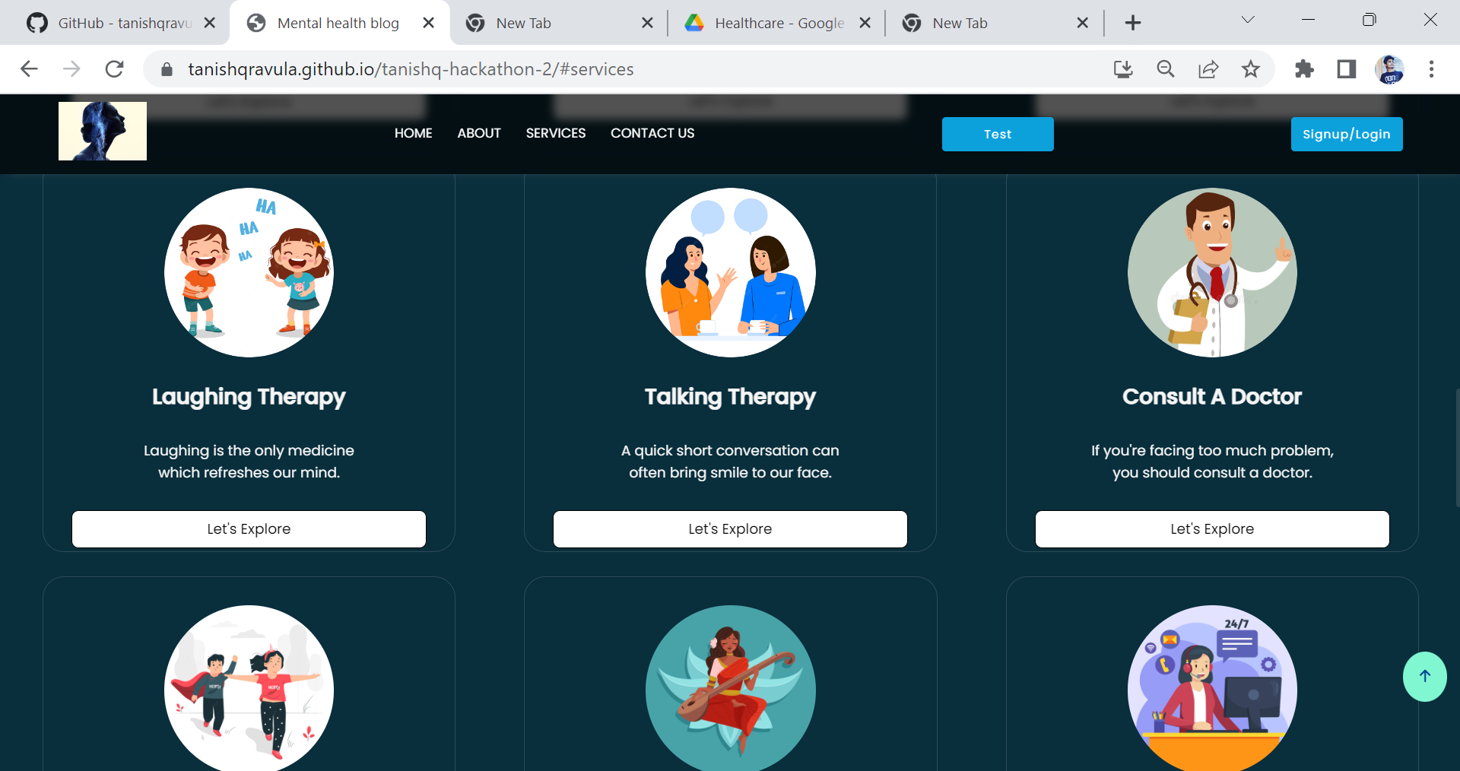
Services:

Slide 8
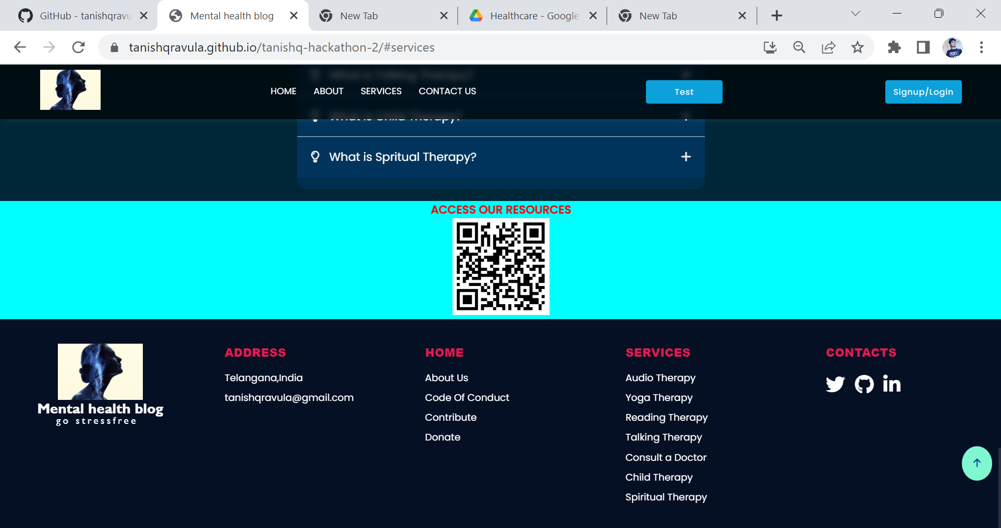
QR Code:

Slide 9
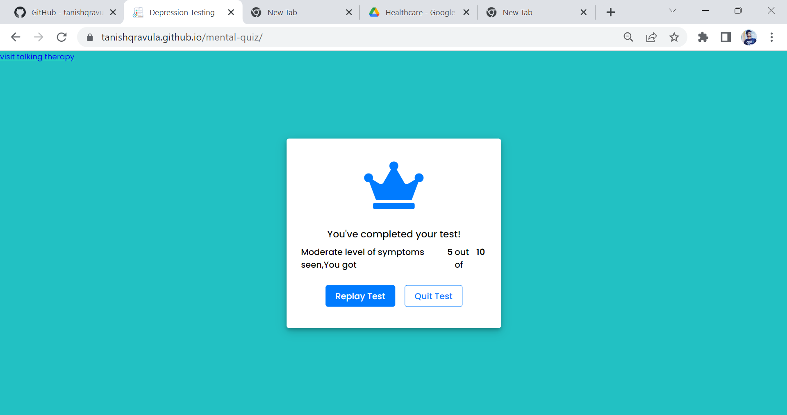
Talk Therapy:

Slide 10
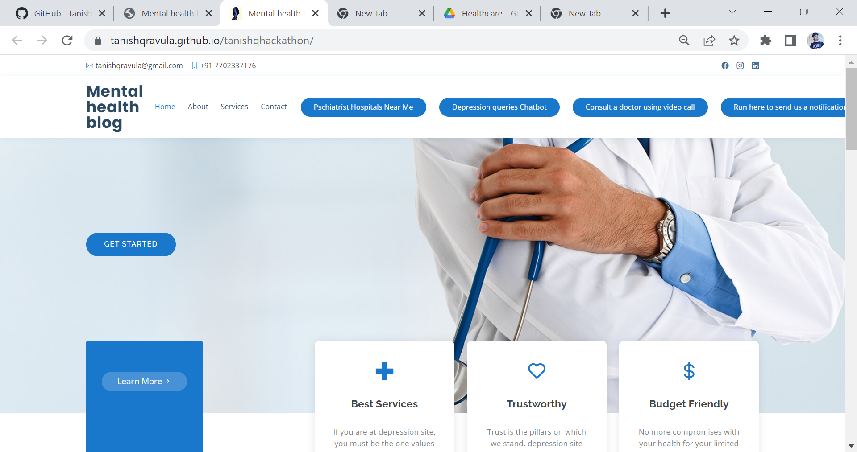
Mental health Blog:

Slide 11
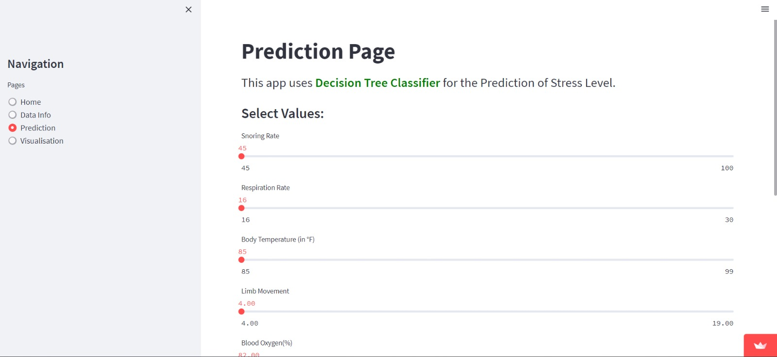
Stress Level Detector

Slide 12
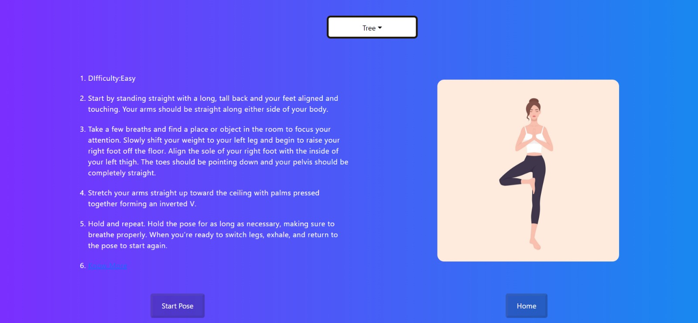
YogaFit:

Slide 13
Idea/Approach Details
Describe your Use Cases here
Describe your Dependencies / Show stopper here
Can lead to a study to find out the particular reason for depression.
It would be benefit to the Job Holders as well as Students.
Can lead to organize a peer-to-peer meetings for lonely ones.
Stream lit
Tensor Flow
React
Xampp

